Slide 1

Making networks consumable
Wim Henderickx
Head of Technology and IP Architecture
AUTOCON1, May 2024
Notes:
Cover slide – no notes

Slide 2

The automation requirements
Consumable
Easy to access, use and extend
Collaborative
Change and Version control
1
3
Predictable
Does it actually work?
Assisted
Leverage the power of AI
2
4

Slide 3
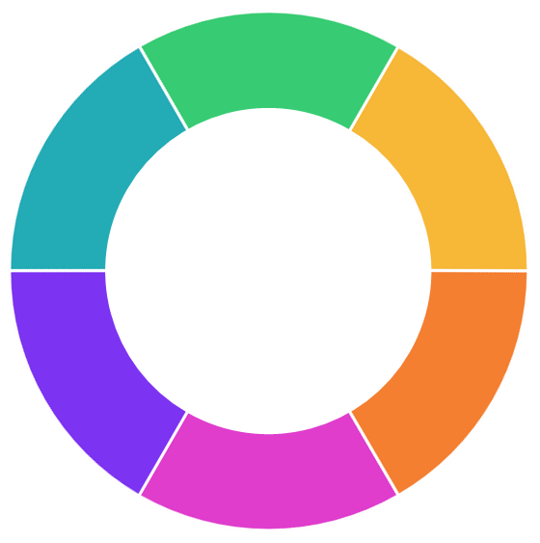
However you consume automation,
consider it a product
Deployment Testing Prototype
Maintenance Concept Design
DIY
Do it yourself
Lifecycle management of automation
DSY
Do some yourself
Minimize effort to run and maintain
DNY
Do none yourself
BENEFITS
Performance at scale
Interoperability
Robustness
Easy upgrade

Slide 4


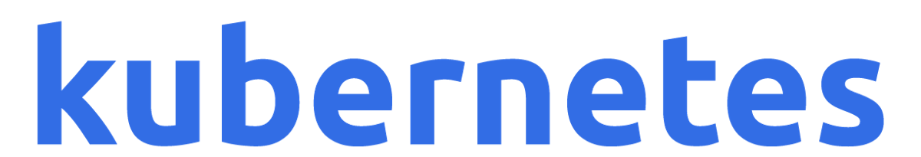


Kubernetes
Containers
Automation and orchestration of
VMs
Clouds
Open Source
API-centric
Declarative
Extendable
Continuous reconciliation
Collaborative (Gitops)
Event-driven
AI enabled
Huge knowledge base
Bare metal
Storage
Server workloads
Applications, Mobile Core/RAN
AI
What about networks?

Slide 5
Demo
Core/Spine
Edge/Leaf
Edge/Leaf

Slide 6
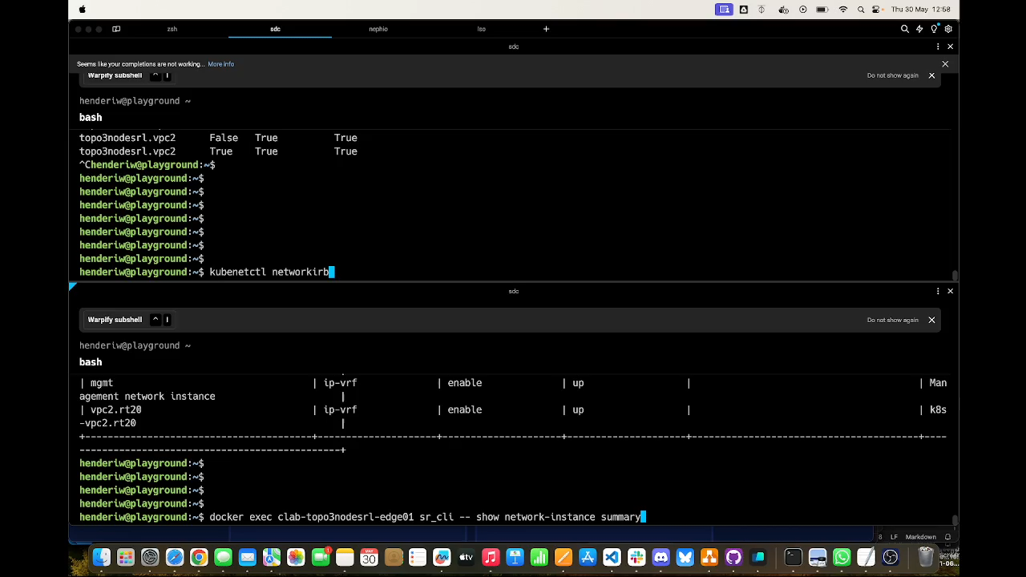
Demo recording

Slide 7
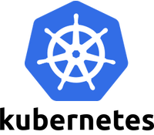
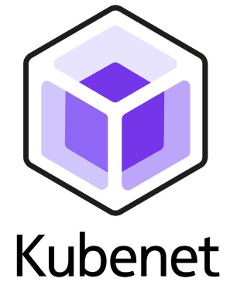




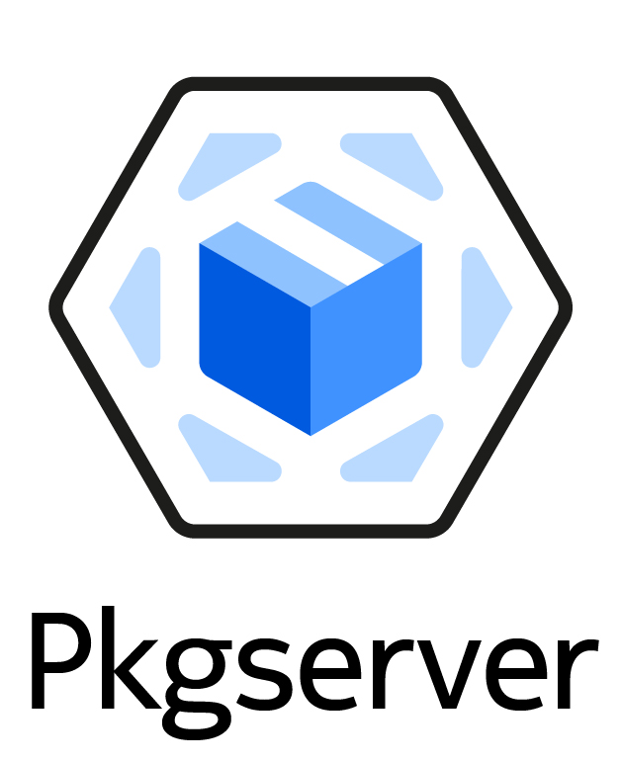
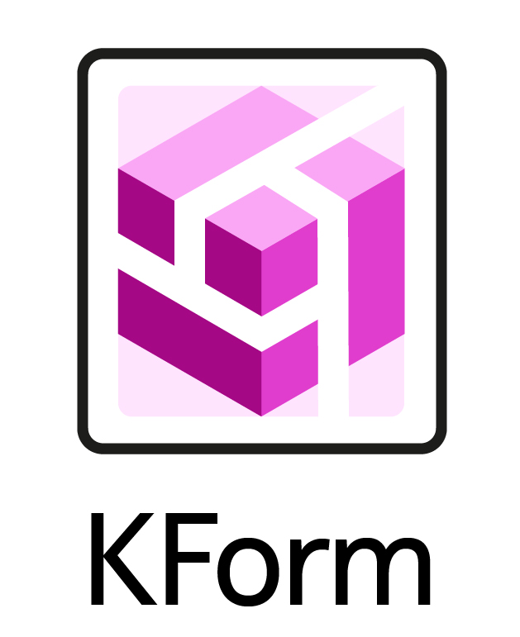




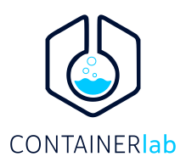

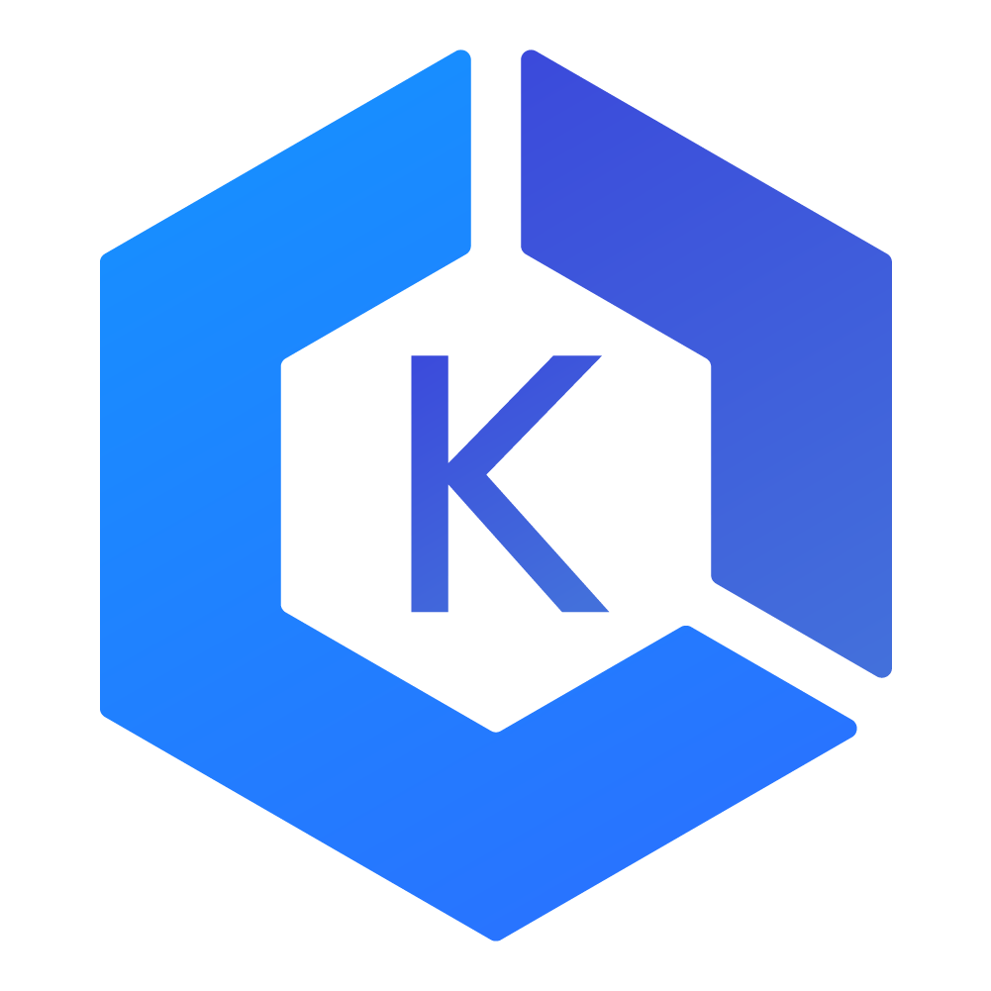

Kubenet initiative
Learn and understand Kubernetes for network automation
Kubenet
Argo CD
Gitlab
KUID
Identity and Inventory system (IPAM, etc)
Pkgserver
Kubernetes API to version control backend (Git, etc)
KForm
Terraform alike implementation using KRM
Cloud Native Computing Foundation
Prometheus
Fluentd
C9s (Clabernetes)
Build labs in K8s
SDC (Schema Driven Config.)
Interact with YANG-based system
Elastic
Grafana
landscape.cncf.io

Slide 8







Making networks consumable with K8s
Join us
youtube.com/channel/ UCZA35_aElDfdsrkY8UwC_eA
discord.gg/fH35bmcTU9
learn.kubenet.dev

Slide 9
Making networks consumable with K8s
Join us
youtube.com/channel/ UCZA35_aElDfdsrkY8UwC_eA
discord.gg/fH35bmcTU9
learn.kubenet.dev

